Slide 1
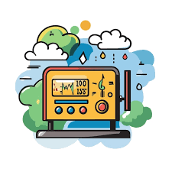
Weather Monitoring System
A Weather Monitoring System measures real-time environmental conditions
Presented by- Akshit Gupta

Slide 2
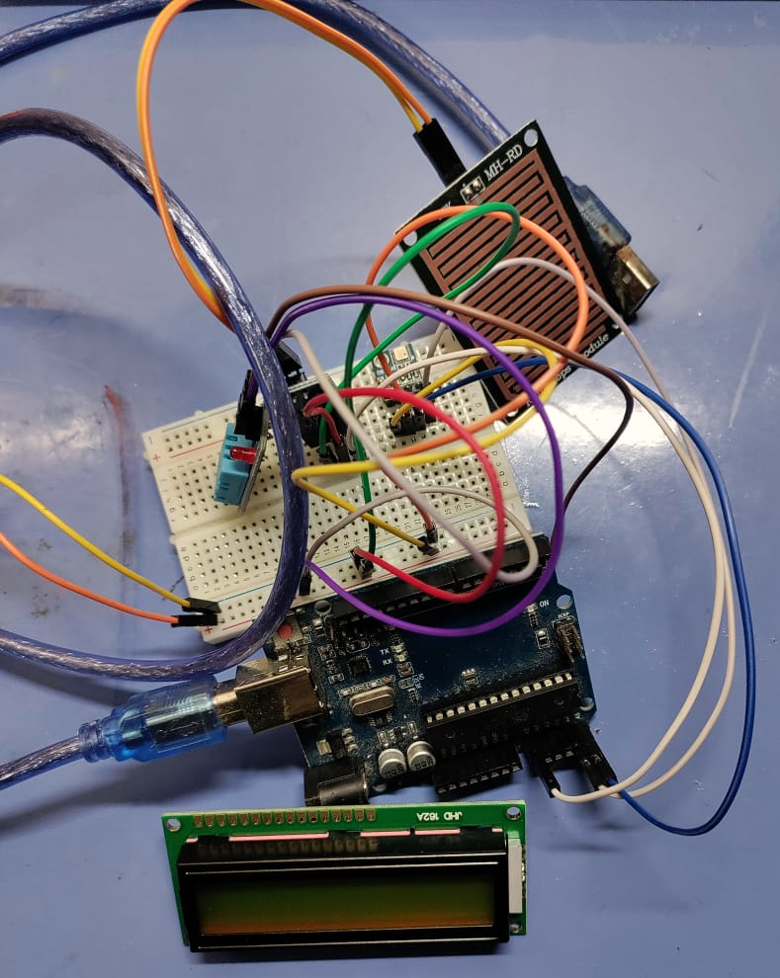
Introduction
A Weather Monitoring System is an electronic setup designed to measure, record, and display various environmental parameters such as temperature, humidity, atmospheric pressure, and rainfall. These systems are commonly used in meteorology, agriculture, and climate research.
This project is based on Arduino Uno, which collects real-time data from various sensors (DHT11, BMP180, and Rain Sensor) and displays it on an LCD screen. It can be extended to store data in a database or send it to a cloud server for remote monitoring.

Slide 3
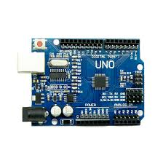
Arduino Uno (Microcontroller)
Description:
Arduino Uno is an open-source microcontroller board based on the ATmega328P.
It has 14 digital input/output pins, 6 analog inputs, a
16 MHz quartz crystal, and can be powered via USB or an external power source.
Role in the Project:
Acts as the central processing unit.
Reads data from sensors, Processes the data and sends it to the LCD display.
Can send data to a computer or cloud for further analysis, that is Supports multiple sensors and communication protocols.

Slide 4
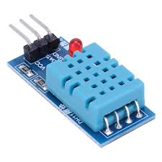
DHT11 Sensor (Temperature & Humidity)
Description:
The DHT11 sensor measures both temperature and humidity.
It uses a thermistor to measure temperature and a capacitive humidity sensor for humidity detection.
It provides data in digital format.
Role in the Project:
Reads temperature and humidity from the environment .
Sends data to Arduino, which processes it and displays it on the LCD.
Helps in climate monitoring and weather prediction.

Slide 5
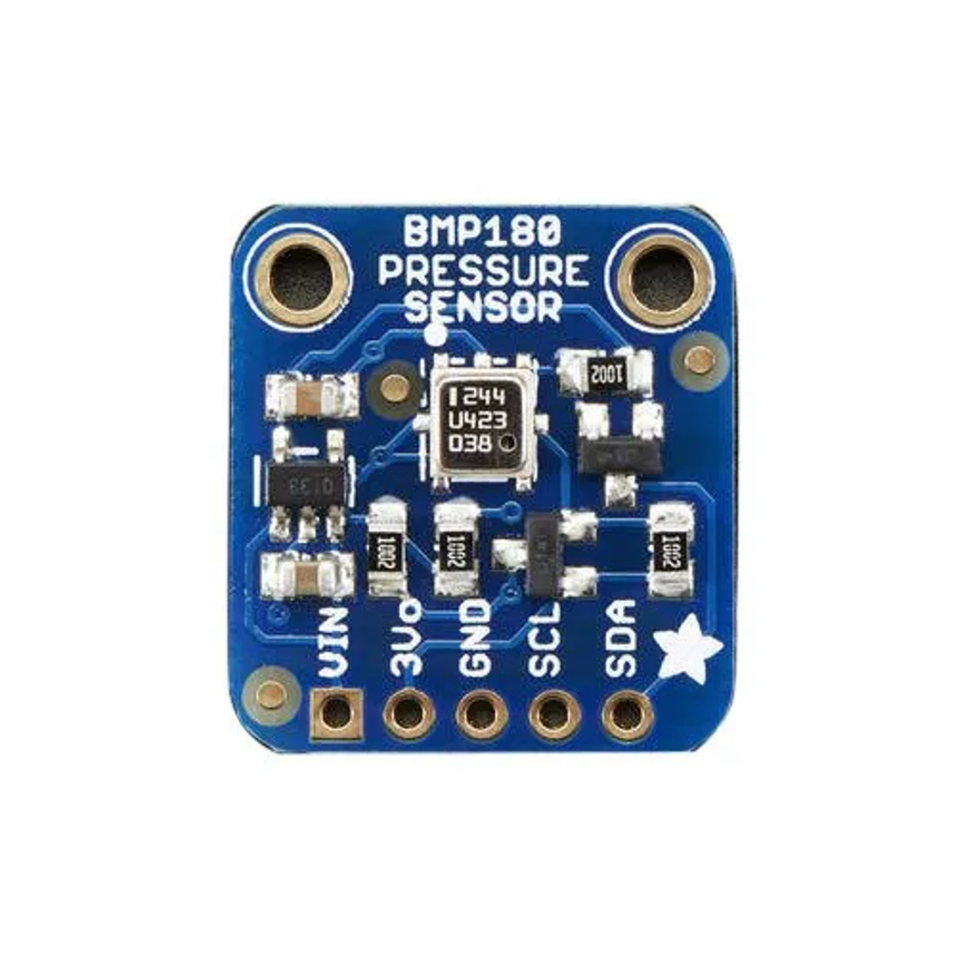
BMP180 Sensor (Barometric Pressure)
Description:
BMP180 is a barometric pressure sensor that measures atmospheric pressure.
It is useful for altitude calculation and weather forecasting.
Works on I2C communication protocol.
Role in the Project:
Measures barometric pressure and provides an estimate of altitude.
Helps in predicting weather changes.
The data can be used for aviation, mountaineering, and meteorology.

Slide 6
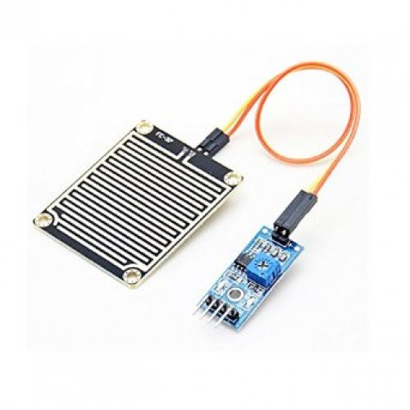
Rain Sensor Module
Description:
The rain sensor detects water droplets and determines if it's raining.
It consists of a rain detection pad and a control module.
Can be used in automatic rain-detection systems.
Role in the Project:
Detects rainfall and sends a signal to Arduino.
Helps in rainwater harvesting and agricultural monitoring.
Can be used in automatic wiper systems for vehicles.

Slide 7
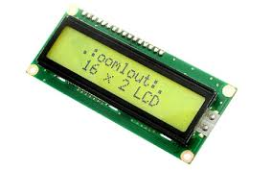
LCD Display (16x2)
Description:
16x2 LCD means it can display 16 characters per line on 2 rows.
It is commonly used to display sensor data in real-time.
Works with I2C interface to reduce the number of required pins.
Role in the Project:
Displays temperature, humidity, pressure, and rainfall data.
Helps in real-time monitoring of weather parameters.

Slide 8
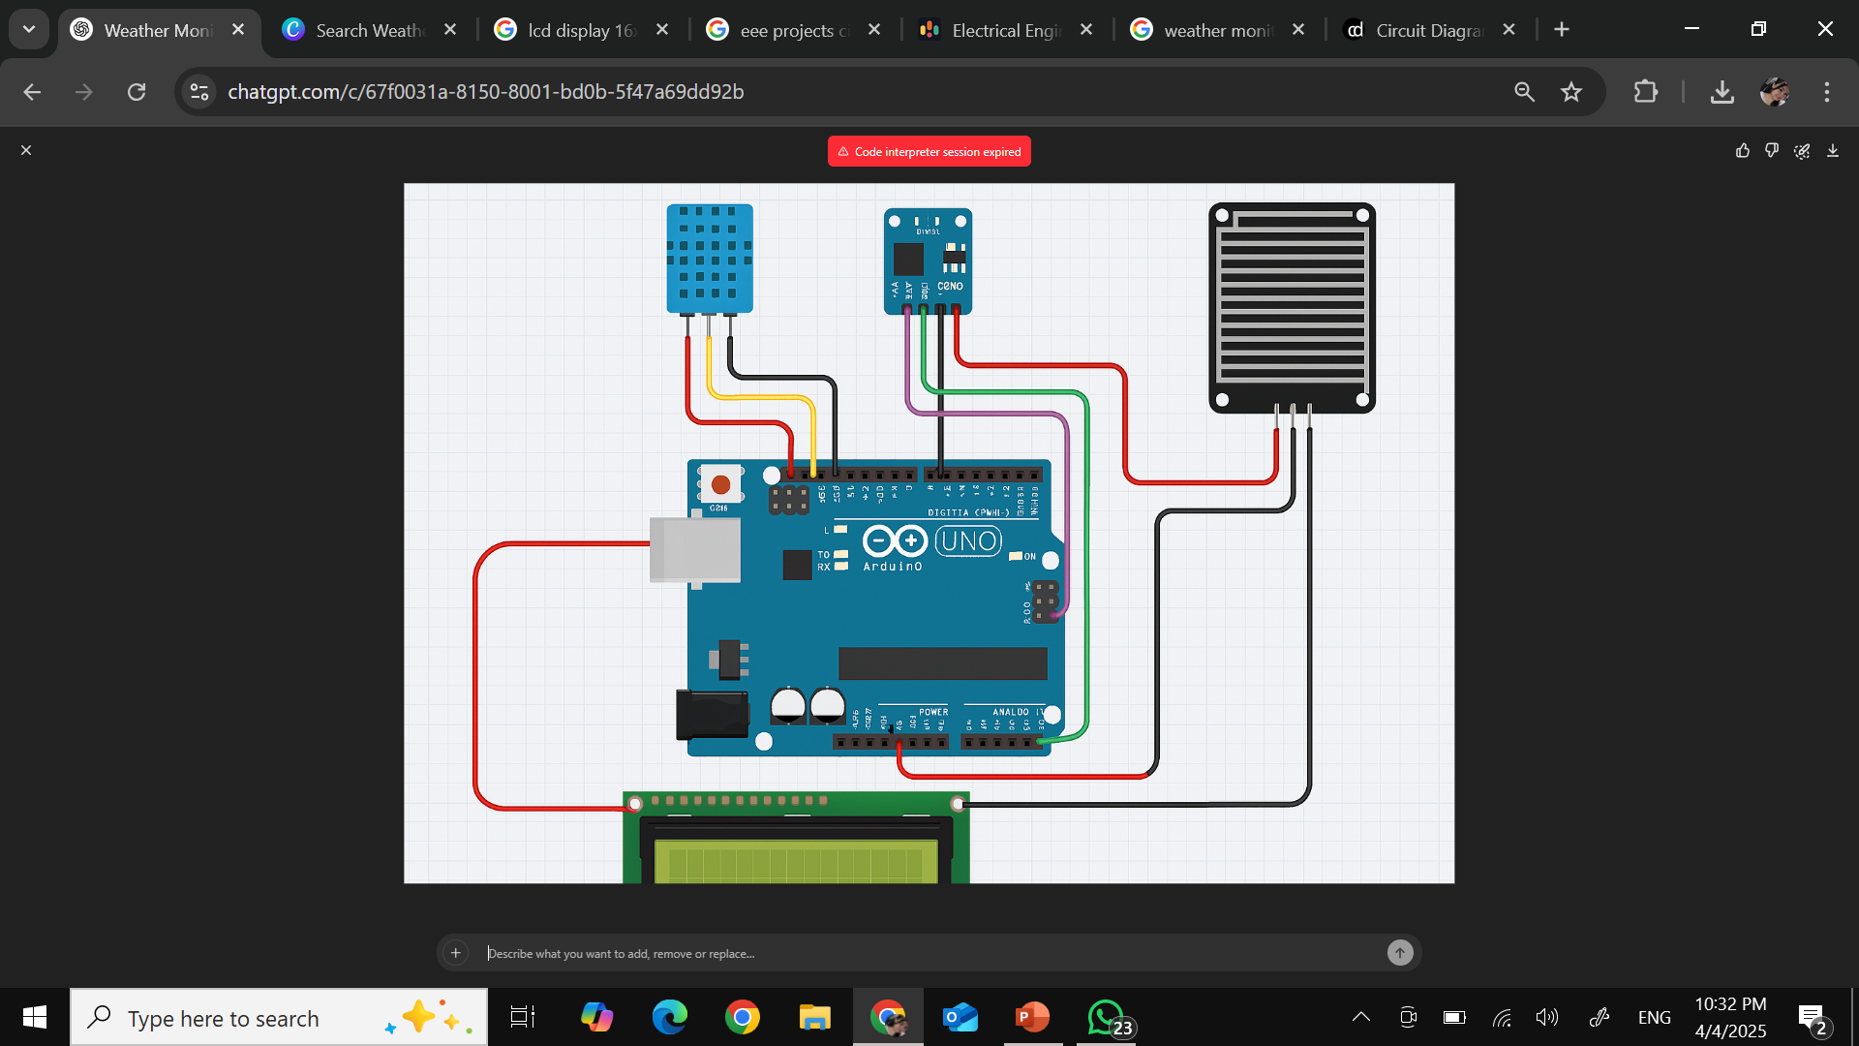
Circuit Diagram
Rain Sensor Module
BMP180 Sensor
DHT11 Sensor
Arduino Uno
LCD Display (16x2)

Slide 9
Working of the Project
Step-by-Step Process:
Powering the System
The system is powered using a USB cable or 9V battery.
2. Sensor Data Collection
DHT11 records temperature & humidity.
BMP180 measures barometric pressure.
Rain Sensor detects rainfall.
3. Processing Data with Arduino
The Arduino Uno collects sensor data and converts it into readable values.
4. Displaying Data on LCD
The real-time temperature, humidity, pressure, and rainfall status are displayed on the 16x2 LCD screen.
5. Continuous Monitoring
The system continuously updates and refreshes data every few seconds.

Slide 10
Applications
🌦️Weather Forecasting
🌾Smart Agriculture
☔Automatic Rain Detection
🌍Environmental Monitoring
🏙️IoT-based Smart Cities

Slide 11
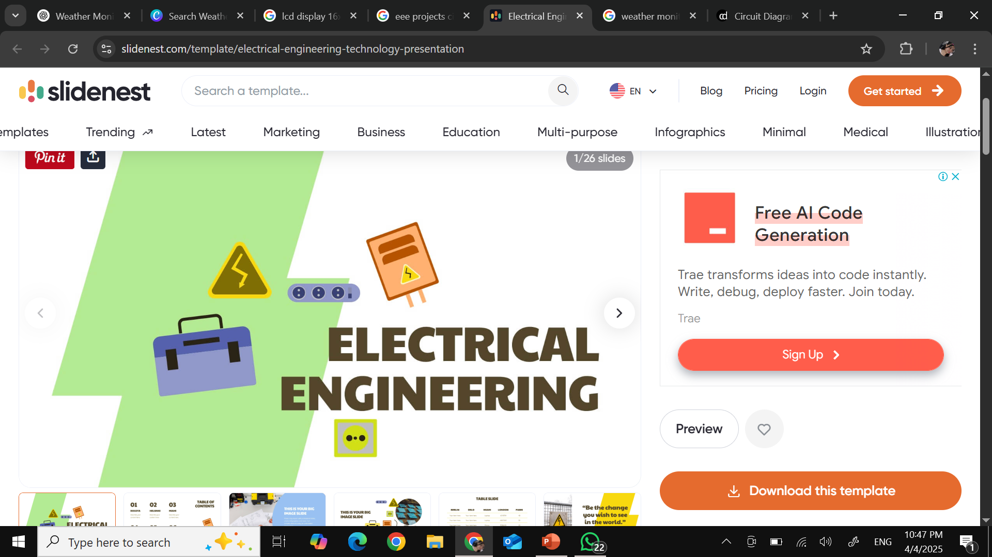
Conclusion
The Weather Monitoring System is a practical and efficient solution for tracking real-time environmental conditions, including temperature, humidity, air pressure, and rainfall.
By integrating sensors with an Arduino Uno microcontroller and displaying the data on an LCD screen, this system provides a simple yet powerful way to monitor weather changes.
It is a cost effective and reliable solution for monitoring weather conditions. It can be further enhanced with IoT and cloud technology and remote weather analysis

Slide 12
THANK YOU

